Slide 1
Anomaly Detection in Network Activities
Submitted in the partial fulfillment for the award of the degree of
BACHELOR OF ENGINEERING
IN
CSE (BIG DATA ANALYTICS)
Submitted by:
A. GEETHA SAATVIK
18BCS3850
K. HARADEEP
18BCS3798
Under the Supervision of:
OCHIN SIR
Department of AIT-CSE
DISCOVER . LEARN . EMPOWER

Slide 2
Outline
Introduction to Project
Problem Formulation
Objectives of the work
Steps to run Project
Methodology used
Results and Outputs
Conclusion
Future Scope
References

Slide 3
Introduction to Project
Network Behavior Anomaly Detection (NBAD) affords a method to network security threat detection.
NBAD is the process of endlessly watching a network for unusual events or trends.
NBAD is an integral part of network behavior analysis (NBA), that offers security in addition to the services provided by ancient anti-threat applications like firewalls, intrusion detection systems, antivirus computer code, and spyware-detection computer code.

Slide 4
Introduction to Project
The mass usage of processed systems has given rise to crucial threats like zero-day vulnerabilities, mobile threats, etc.
The evolution of laptop networks has greatly exacerbated laptop security considerations, notably web security in today's networking setting and advanced computing facilities.
Anomaly detection is a crucial knowledge analysis task that detects abnormal or malicious knowledge from a given dataset.

Slide 5
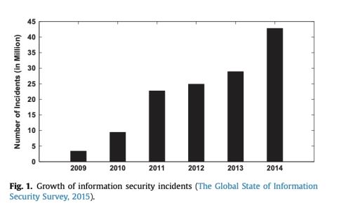
Problem Formulation
Our project concerns the field of Cyber Security and aims at detecting DOS or DDOS attacks.
The project presented below is developed with the sole motive of detecting a DOS attack by distinguishing it from legitimate network traffic efficiently.

Slide 6
Objectives
Analysis of Network Places.
Showing Statistics of different places.
In this project we are sniffing packets with respect to six protocols namely: TCP, UDP, DNS, IP, FTP, and HTTP.
After updating the count for each protocol, the program plots the pie chart, bar graph, time slot. Detecting DOS and DDOS attacks.

Slide 7
Steps to run Project
Open Spyder in Anaconda Navigator.
Run our code.
Install Scapy library(if not there)
Install Winprap in PC(if not there)
Install SwitchBlade for artificially generating DOS attacts
Again open Syper and run the code.
Suffer internet so that differt network packets get detected by our project.
Artificially generate DO DOS ATTACKS,our project recognizes it and displays a warning message.

Slide 8
Methodology used
In our project, we make use of the Scapy Library of Python to sniff network packets.
The Tkinter Library is used to make the GUI in python to provide the user with a more interactive interface.
The Matplotlib Library is used to plot the pie chart, the bar graph, and the time plot.

Slide 9
Methodology used
The Math Library is used to do some mathematical formatting.
The Time library is used to get the current time.

Slide 10
Results and Outputs
In our project, the pie chart indicates the percentage of the total number of packets that belong to each protocol.
The bar graph gives us information about the total number of packets with respect to each protocol.
The time plot gives us information about the total number of packets belonging to each protocol with respect to time spent after starting the evaluation.

Slide 11
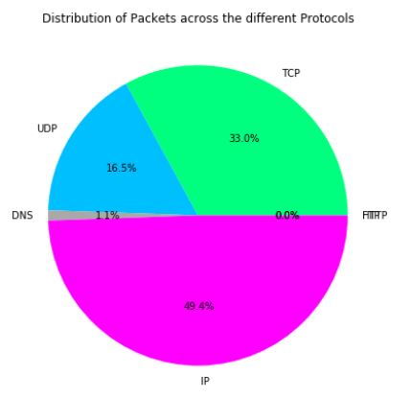
Results and Outputs
Our project helps users to keep track of their live internet traffic and detect an anomaly whenever there is a DOS attack.

Slide 12
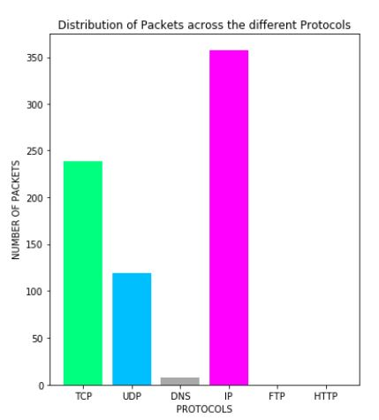
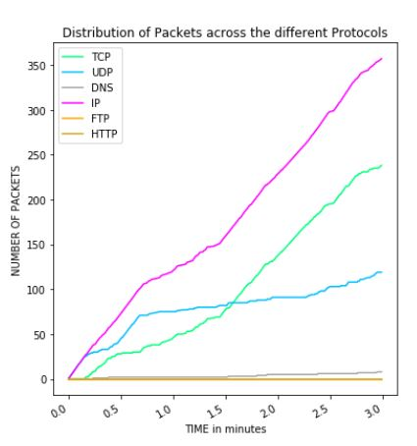
Results and Outputs

Slide 13

Results and Outputs
If such an anomaly occurs, a message box - created with the help of the Tkinter Library of Python - pops up notifying the anomaly and the program breaks out of the loop.

Slide 14
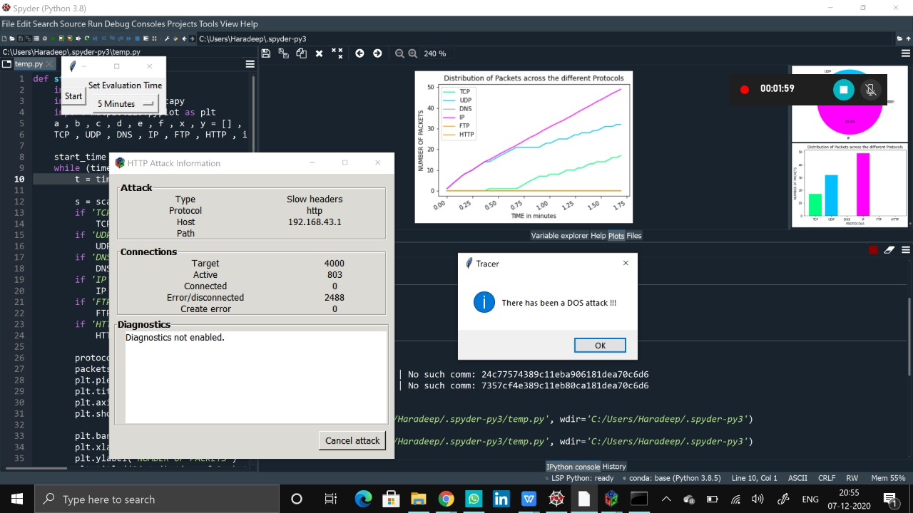
Results and Outputs

Slide 15
Conclusion
Faster computation speeds.
Lighter and more efficient software.
Ability to detect the name of the protocol that had been used to launch the attack.
Large scale implementation of our project in industrial servers.
For PC users, we have come up with an idea to tailor our software according to their daily needs. Internet usage is not the same throughout the day and often varies widely across the days of the week. So with the help of Artificial Intelligence we have attempted to study the daily and timely internet usage patterns of users and as a result be better able to differentiate between legitimate requests and attacks.

Slide 16
Future Scope
We can make our software much lighter, much faster and gives users the accurate real time information about the network traffic in their computer.
We can also make our software’s user interface much better.
We will make our software to monitor everything about your network and the packet flow going through it.
In addition to this, we can also track other attacks also apart from DOS and DDOS attacks.

Slide 17
References
Petersen, B. and Chung, E., Broadcom Corp, 2009. Network activity anomaly detection. U.S. Patent Application 12/015,387.
Garcia-Teodoro, P., Diaz-Verdejo, J., MaciáFernández, G. and Vázquez, E., 2009. Anomaly-based network intrusion detection: Techniques, systems and challenges. computers & security, 28(1-2), pp.18-28.
Krügel, C., Toth, T. and Kirda, E., 2002, March. Service specific anomaly detection for network intrusion detection. In Proceedings of the 2002 ACM symposium on Applied computing (pp. 201-208).
Simmross-Wattenberg, F., Asensio-Perez, J.I., Casaseca-De-La-Higuera, P., Martin-Fernandez, M., Dimitriadis, I.A. and Alberola-Lopez, C., 2011. Anomaly detection in network traffic based on statistical inference and\alpha-stable modeling. IEEE Transactions on Dependable and Secure Computing, 8(4), pp.494-509.
Gao, J., Hu, G., Yao, X. and Chang, R.K., 2006, August. Anomaly detection of network traffic based on wavelet packet. In 2006 Asia-Pacific Conference on Communications (pp. 1-5). IEEE.

Slide 18
References
Chan, P.K., Mahoney, M.V. and Arshad, M.H., 2005. Learning rules and clusters for anomaly detection in network traffic. In Managing Cyber Threats (pp. 81-99). Springer, Boston, MA.
Noble, C.C. and Cook, D.J., 2003, August. Graphbased anomaly detection. In Proceedings of the ninth ACM SIGKDD international conference on Knowledge discovery and data mining (pp. 631-636).
Pavithirakini, S., Bandara, D.D.M.M., Gunawardhana, C.N., Perera, K.K.S., Abeyrathne, B.G.M.M. and Dhammearatchi, D., 2016. Improve the Capabilities of Wireshark as a tool for Intrusion Detection in DOS Attacks. International Journal of Scientific and Research Publications, 6(4), pp.378-384.
Othman, Z.A. and Eljadi, E.E., 2011, July. Network anomaly detection tools based on association rules. In Proceedings of the 2011 International Conference on Electrical Engineering and Informatics (pp. 1-7). IEEE.
Mantere, M., Sailio, M. and Noponen, S., 2014, April. A module for anomaly detection in ICS networks. In Proceedings of the 3rd international conference on High confidence networked systems (pp. 49-56).

